Slide 1
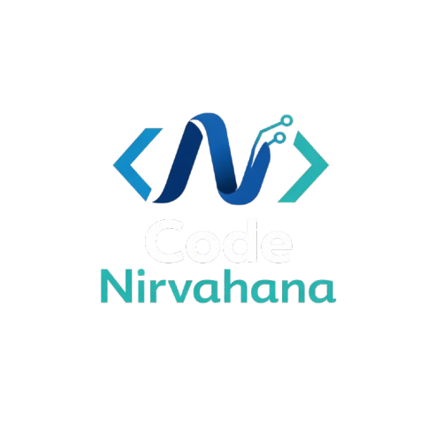
TOP 5 PROGRAMMING LANGUAGES TO LEARN IN 2026
By codeNirvahana

Slide 2
TOP 5 PROGRAMMING LANGUAGES FOR 2026
Based on the latest industry rankings and adoption data from Tiobe Index and global usage trends, the top 5 programming languages are:
Python — 28.97% usage share (Leader)
Java — 13.94% usage share (Enterprise & Backend)
C/C++ — 10.54% usage share (Systems & Performance)
C# — 6.94% usage share (Microsoft/.NET & Game Dev)
JavaScript — 3.41% usage share (Web & Full-Stack)

Slide 3
Python — The #1 Language
What is Python?
Python is a high-level, readable language used for general-purpose programming.
Applications:
  Data Science & Machine Learning
  Web development (Django, Flask)
  Automation & Scripting
  Scientific computing
Domain Usage:
AI, ML, Data Analytics, Web apps, Automation
Salary Range (India): ₹4–15 LPA
Salary Range (Global): $80,000–$140,000 USD
Why Learn Python?
Easy syntax for beginners
Huge library ecosystem
Strong community & job market

Slide 4
Java — Enterprise & Backend Powerhouse
JAVA PROGRAMMING LANGUAGE
What is Java?
Java is an object-oriented language widely used in enterprise applications and Android development.
Applications:
Enterprise backend systems
Android mobile apps
Cloud applications
Domain Usage:
Enterprise software, Android, Financial tech
Salary Range (India): ₹5–18 LPA
Salary Range (Global): $90,000–$150,000 USD
Why Learn Java?
Platform-independent (Write Once Run Anywhere)
Strong presence in big companies
High demand in backend & enterprise systems

Slide 5
C & C++ — Performance and Systems Programming
What are C and C++?
C and C++ are foundational languages that provide control over system resources and performance.
Applications:
Operating systems
Embedded systems
Game engines
High-performance computing
Domain Usage:
Systems programming, game engines, hardware-level development
Salary Range (India): ₹6–20 LPA
Salary Range (Global): $90,000–$160,000 USD
Why Learn C/C++?
Great for understanding computer architecture
Required for performance-critical systems

Slide 6
C# — .NET & Game Development
What is C#?
C# is a language developed by Microsoft, primarily used with the .NET framework.
Applications:
Desktop applications (Windows)
Web APIs
Game development (Unity)
Domain Usage:
.NET ecosystem, game dev, enterprise apps
Salary Range (India): ₹5–17 LPA
Salary Range (Global): $80,000–$140,000 USD
Why Learn C#?
Excellent for beginners transitioning to professional dev
Large ecosystem with Unity for games

Slide 7
JAVASCRIPT PROGRAMMING LANGUAGE
What is JavaScript?
JavaScript is the core language of the web used in frontend and backend (Node.js).
Applications:
Frontend web development
Backend with Node.js
Full-stack JavaScript projects
Domain Usage:
Web development, interactive interfaces
Salary Range (India): ₹4–15 LPA
Salary Range (Global): $75,000–$130,000 USD
Why Learn JavaScript?
Essential for web development
Universal language for client & server

Slide 8
Conclusion
Top 5 programming languages to learn for 2026:
Python
Java
C / C++
C#
JavaScript
Recommendation for Beginners:
Start with Python — easy syntax and versatile usage. Then progress to JavaScript or Java for web and backend applications.
Learning multiple languages increases job opportunities and problem-solving skills.

